Slide 1
Drone Operations in the vicinity of Goodwood Aerodrome

Slide 2
Introduction
This presentation is to inform you of an upcoming project at Goodwood Aerodrome.
In this presentation we aim to let you know who we are, what the project involves and answer any questions you may have.

Slide 3
Introduction
A consortium of UK companies, Trax, Planefinder, uAvionix and ANRA Technologies has been awarded UK Research and Innovation (UKRI) Funding because the technical solution proposed by the project was considered an essential enabler for a multitude of projects that would allow more effective recovery from existing and/or future CV19 impacts.
The consortium is also working with the Goodwood Aviation Innovation Centre and Skyports, a drone operator.
Goodwood Aerodrome have agreed to host the project. However, they have stated that it must not negatively impact the Goodwood operations, their customers or communities

Slide 4
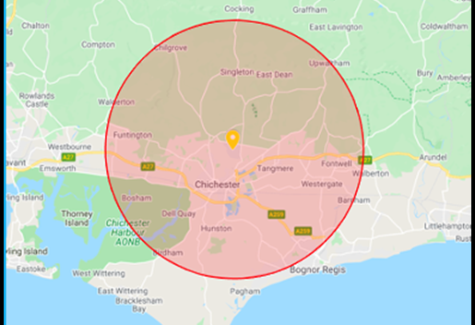
The Project – Phase One
The project aims to gradually demonstrate drone operations that are Beyond Visual Line of Sight of the drone operator are safe and can meet with regulatory approval whilst still providing safe and efficient access to the airspace by all airspace users.
To develop these procedures, the first phase is to request the establishment of some restricted airspace from the Civil Aviation Authority. This means we can ensure no other aircraft are in the airspace whilst we test the drone procedures.
We must request the restricted airspace from the Civil Aviation Authority and follow the process they require.
The restricted airspace we are proposing is in the same location as one previously established (but not used) by Goodwood Aviation Innovation Centre earlier this year.
The restricted airspace itself has no impact to those on the ground and therefore we would not normally engage yourselves on this aspect.

Slide 5
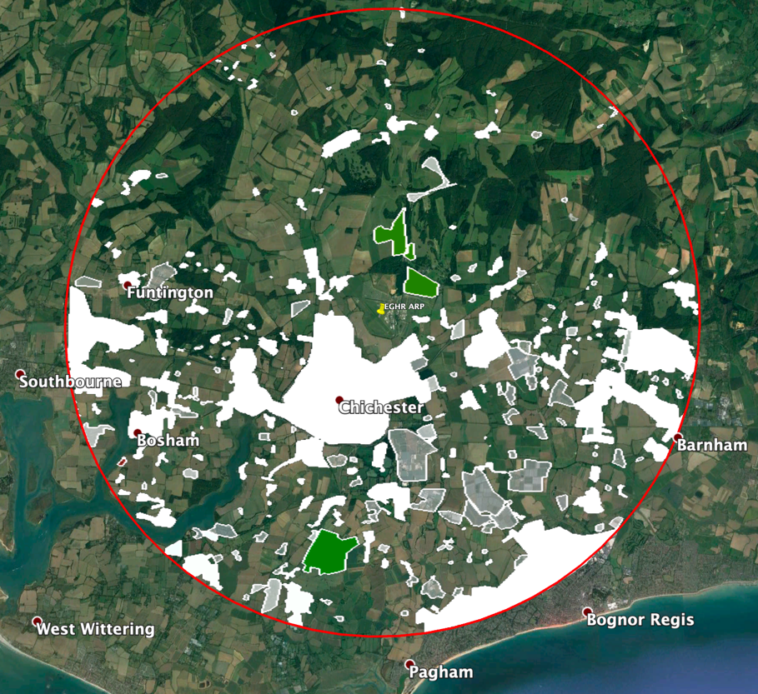
Addressing Community Concerns
Although engagement with community stakeholders is not usually required by the Civil Aviation Authority in order to establish restricted airspace, we believe that you may be interested in this project and what it means for your communities.
We don’t yet know if there will be specific routes for the drones or if they will be flexible, but we have mapped out ALL residential, built up or potentially populated areas (See image to the right).
Flight routes will be planned in such a way to meet ALL safety requirements and we aim to avoid overflight of any residences by at least 150m laterally which will aim to mitigate any noise and/or nuisance aspects.
We currently envisage there will be up to 12 drone movements in any one day that the restricted airspace is active. This would comprise of 12 take-offs and 12 landings.
The restricted airspace will not be active every day.

Slide 6
Noise from the drones
As a relatively new technology, there is very limited information publicly available about the noise created by drones.
The main drone being used for this project has two modes of operation; multicopter and fixed wing mode. Multicopter is used for take-off and landing and fixed wing is used during flight.
When in fixed wing mode and above 400ft, the main drone operator states that it is almost imperceptible from the ground.
It is anticipated that the main drone will usually only operate in multicopter mode within the Goodwood Aerodrome boundary.
We believe the limited noise from the drones together with the requirement to avoid all residential and populated areas will mean noise impacts should be negligible. However, we will provide contact details throughout the trial period to allow you to contact us about the trial.

Slide 7
Feedback
We hope this presentation has informed you about our project and answered any concerns you may have.
Your feedback on this project is important to us. We would like to know of any feedback you have from a local community perspective.
Please email your feedback to by 15th January 2021 at goodwoodbvlos@traxinternational.co.uk

